Slide 1
Structural features of ubiquitin
Laura Martínez (152691), Marina Reixachs (152699), Gemma Vidal (154235)
Structural Biology
UPF 2014-2015

Slide 2
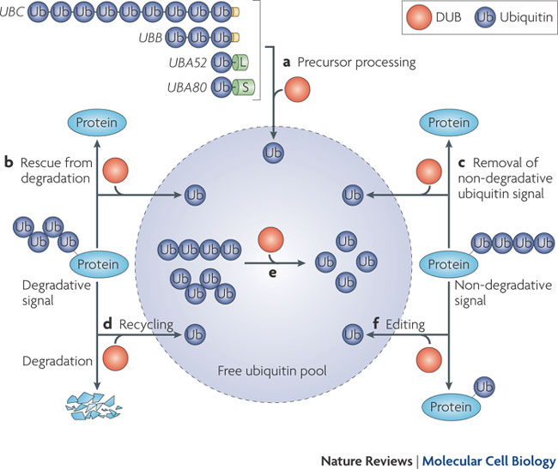
introduction
INTRODUCTION
UBIQUITIN
POLYUBIQUITIN
E1 ENZYMES
CONCLUSIONS
76-amino-acid polypeptide
Molecular Weight of 85 kDa
Highly conserved in eukaryotes
Expressed in most cell types
Komander D, Claque MJ, Urbé S. Breaking the chains: structure and function
of the deubiquitinases. Nature Reviews. 2009; 10:550-563

Slide 3
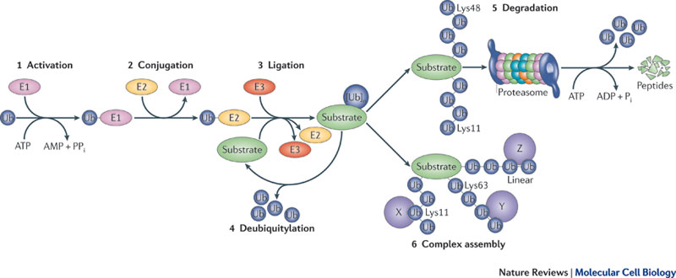
introduction
INTRODUCTION
UBIQUITIN
POLYUBIQUITIN
E1 ENZYMES
CONCLUSIONS
Human genome
Number of E1 | 1
Number of E2 | 30
Number of E3 | 500
Vucic D, Dixit VM, Wertz HE. Ubiquitylation in apoptosis: a post-translational modification at the edge of life and death. Nature Reviews. 2011; 12:439-452

Slide 4
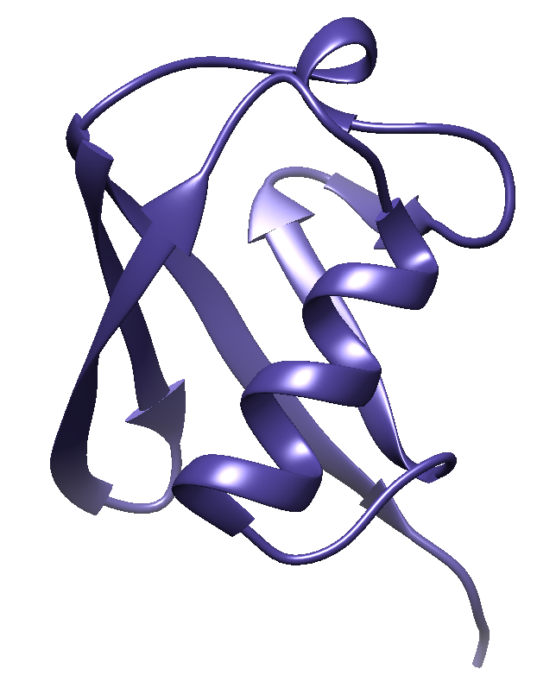
INDEX
1. Introduction
2. Ubiquitin
2.1. SCOP
2.2. Secondary structure
2.3. Origin and conservation
2.4. Ubiquitin-like proteins
2.5. Relevant residues
3. Polyubiquitins
3.1. Linear chains (K63, M1)
3.2. Tetraubiquitin (K48)
4. E1 enzymes
4.1. Domains
4.2. Interaction with ubiquitin
4.3. Adenylation reaction
4.4. Thioester bond
5. Conclusions

Slide 5
Ubiquitin and UBL

Slide 6
avAILABLE STRUCTURES
INTRODUCTION
UBIQUITIN
POLYUBIQUITIN
E1 ENZYMES
CONCLUSIONS
PDB code | Protein | Species | Resolution | Release date
1UBQ | Ubiquitin | Homo sapiens | 1.80 Å | 1987
1U4A | SUMO | Homo sapiens | NMR | 2005
1XT9 | NEDD8 | Homo sapiens | 2.20 Å | 2004
2JF5 | Diubiquitin (Lys63) | Homo sapiens | 1.95 Å | 2008
2W9N | Diubiquitin (Met1) | Homo sapiens | 2.25 Å | 2009
1F9J | Tetraubiquitin (Lys48) | Homo sapiens | 2.70 Å | 2001
1JW9 | MoaD | Escherichia coli | 1.70 Å | 2001
1ZUD | ThiS | Escherichia coli | 1.98 Å | 2006
2QJL | Urm1 | Saccharomyces cerevisiae | 1.44 Å | 2007

Slide 7
SCOP
INTRODUCTION
UBIQUITIN
POLYUBIQUITIN
E1 ENZYMES
CONCLUSIONS
Class
Alpha and beta proteins (a+b)
Mainly antiparallel beta sheets (segregated alpha and beta regions)
Fold
Beta-Grasp (ubiquitin-like)
Core
beta(2)-alpha-beta(2); mixed beta-sheet
Ubiquitin-like
Family
Protein
Super-family
Ubiquitin-related
Ubiquitin
1UBQ

Slide 8
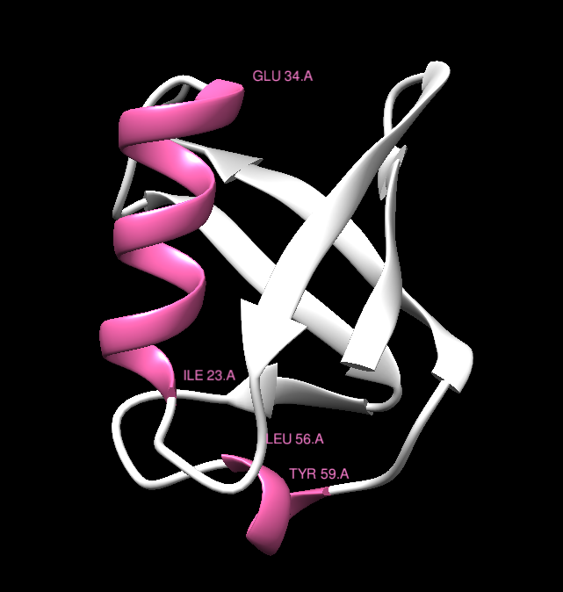
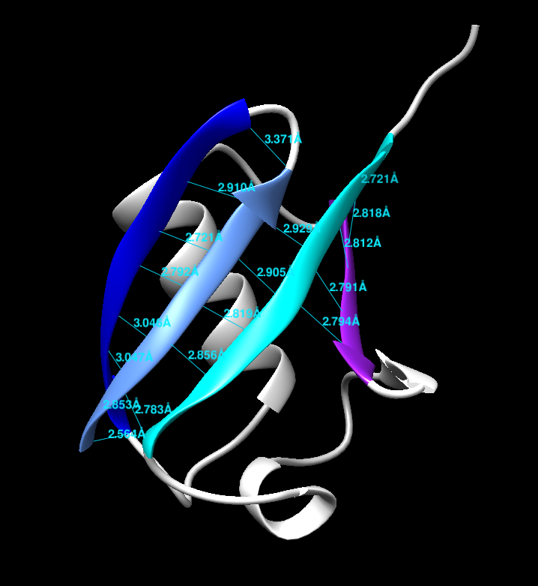
Secondary structure
INTRODUCTION
UBIQUITIN
POLYUBIQUITIN
E1 ENZYMES
CONCLUSIONS
4 β-strands:
antiparallel mixed β-sheet
α-helix
3¹⁰ helix
1UBQ
1UBQ

Slide 9
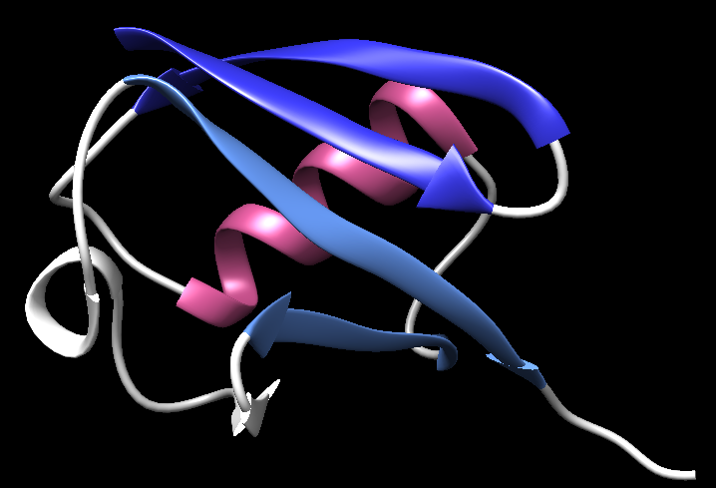
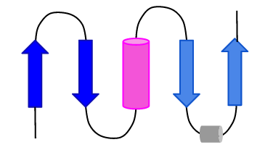
Secondary structure
INTRODUCTION
UBIQUITIN
POLYUBIQUITIN
E1 ENZYMES
CONCLUSIONS
Core:
2β -α-2β
1UBQ

Slide 10
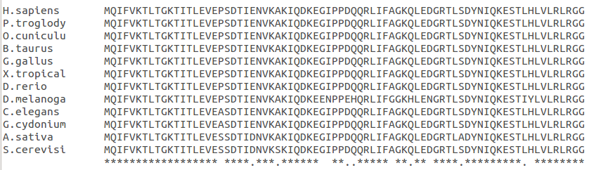
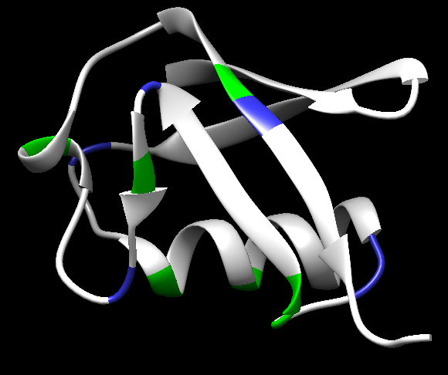
Origin and conservation
INTRODUCTION
UBIQUITIN
POLYUBIQUITIN
E1 ENZYMES
CONCLUSIONS
ClustalW
1UBQ
Similar residues
β1
β2
α-helix
β3
3₁₀ helix
β4
Different residues

Slide 11
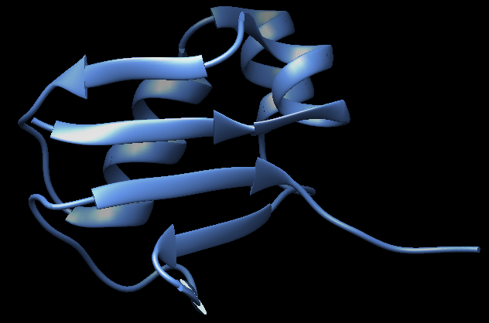
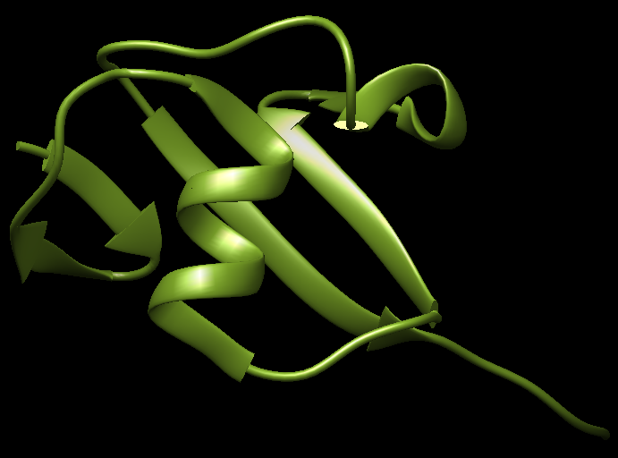
Origin and conservation
INTRODUCTION
UBIQUITIN
POLYUBIQUITIN
E1 ENZYMES
CONCLUSIONS
T-coffee
1JW9
MoaD
1ZUD
ThiS

Slide 12
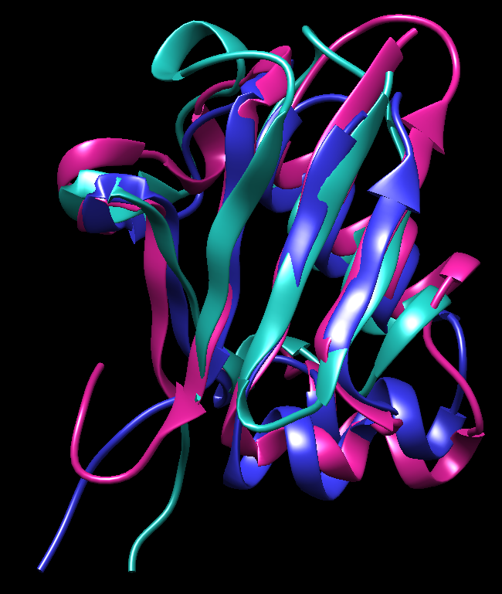
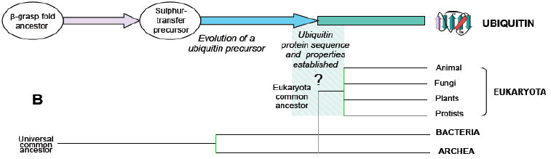
Origin and conservation
INTRODUCTION
UBIQUITIN
POLYUBIQUITIN
E1 ENZYMES
CONCLUSIONS
MoaD | 1JW9
Urm1 | 2QJL
Ub | 1UBQ
STAMP
RMSD 2.09
Zuin A, Isasa M, Crosas B. Ubiquitin signaling: extreme conservation as a source of diversity. Cells. 2014; 3(3):690-701.

Slide 13
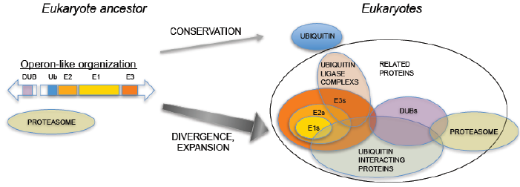
Origin and conservation
INTRODUCTION
UBIQUITIN
POLYUBIQUITIN
E1 ENZYMES
CONCLUSIONS
Zuin A, Isasa M, Crosas B. Ubiquitin signaling: extreme conservation as a source of diversity. Cells. 2014; 3(3):690-701.

Slide 14
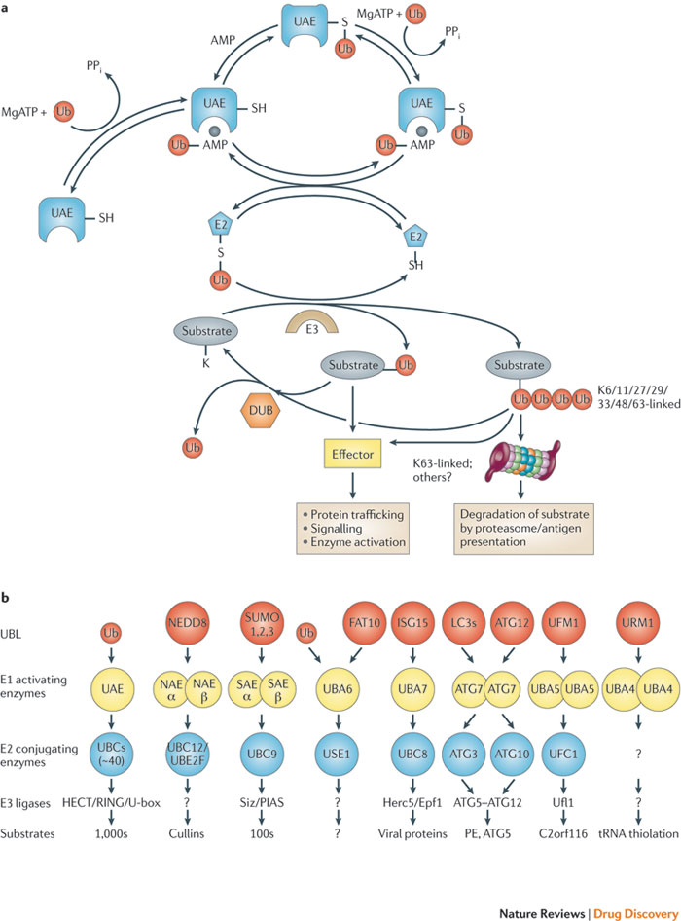
UBIQUITIN-LIKE PROTEINS
INTRODUCTION
UBIQUITIN
POLYUBIQUITIN
E1 ENZYMES
CONCLUSIONS
Bedford L, Lowe J, Dick LR, R. Mayer J, Brownell JE. Ubiquitin-like protein conjugation and the ubiquitin–proteasome system
as drug targets. Nature Reviews. 2011; 10: 29-46.

Slide 15
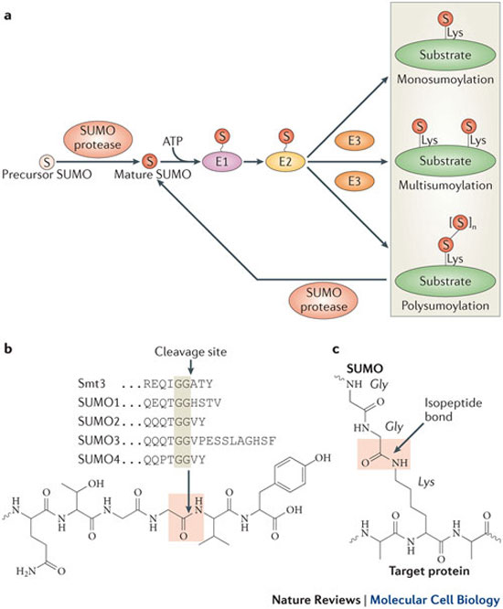
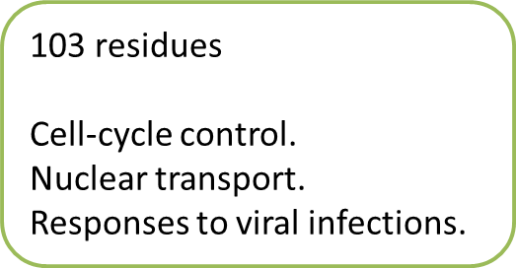
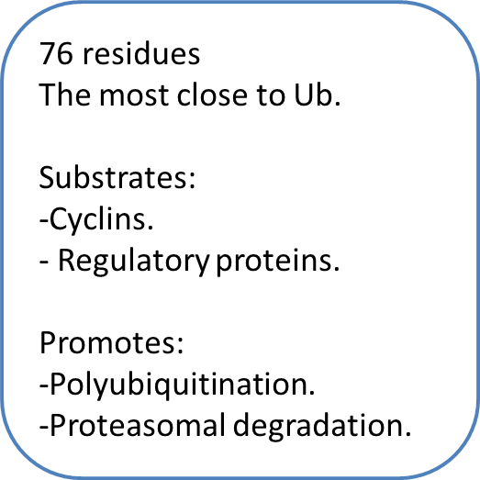
UBIQUITIN-LIKE PROTEINS
UBIQUITIN LIK PROTEINS
SUMO
INTRODUCTION
UBIQUITIN
POLYUBIQUITIN
E1 ENZYMES
CONCLUSIONS
SUMO
NEDD8
Hickey CM, Wilson NR, Hochstrasser M. Function and regulation of SUMO proteases. Nature Reviews. 2012; 13: 755-766.

Slide 16
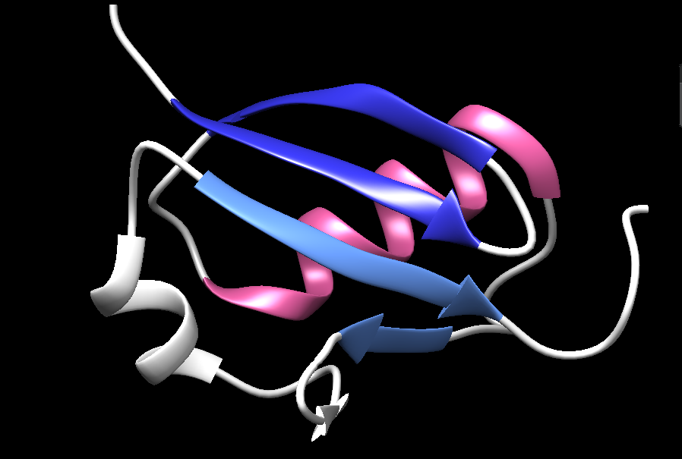
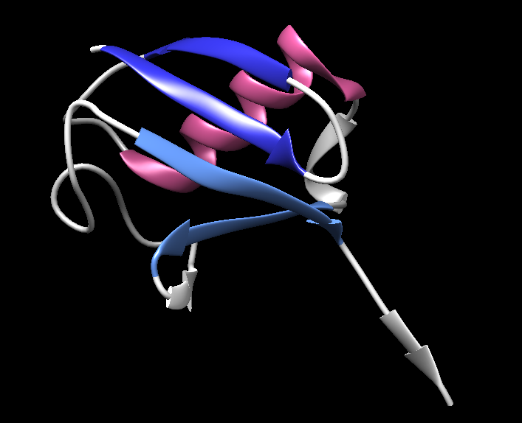
UBIQUITIN-LIKE PROTEINS
UBIQUITIN LIKE PROTEINS
NEDD8
INTRODUCTION
UBIQUITIN
POLYUBIQUITIN
E1 ENZYMES
CONCLUSIONS
SUMO
NEDD8
1U4A
1XT6

Slide 17
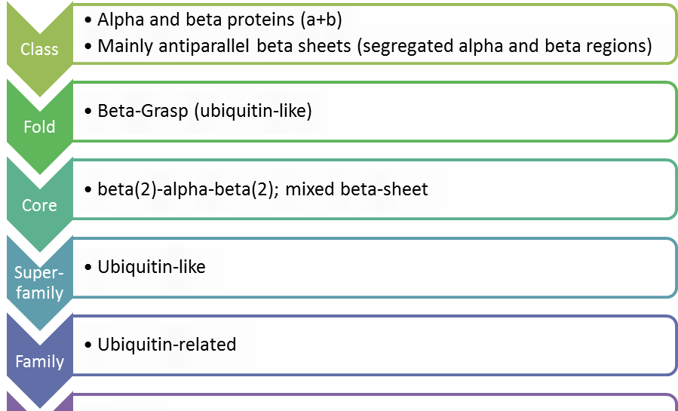
UBIQUITIN-LIKE PROTEINS
UBIQUITIN LIKE PROTEINS
SUMO
INTRODUCTION
UBIQUITIN
POLYUBIQUITIN
E1 ENZYMES
CONCLUSIONS
Protein
SUMO
Protein
NEDD8

Slide 18
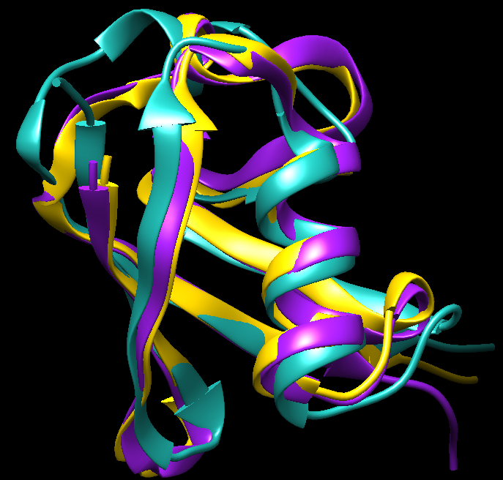
UBIQUITIN-LIKE PROTEINS
INTRODUCTION
UBIQUITIN
POLYUBIQUITIN
E1 ENZYMES
CONCLUSIONS
STAMP
NEDD8 more similar than SUMO to Ubiquitin
Ub | 1UBQ
NEDD8 | 1XT9
SUMO | 1U4A
RMSD 1.62

Slide 19
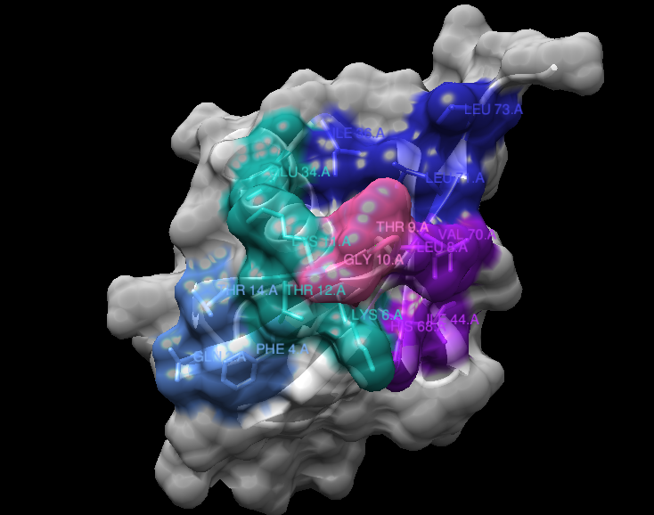
Relevant residues
INTRODUCTION
UBIQUITIN
POLYUBIQUITIN
E1 ENZYMES
CONCLUSIONS
1UBQ
Mitotic degradation
TEK-box
Ile36 patch
Ubiquitin chains
E3 interaction
K6, K11, T12, T14
L71, L73, L8, I36
β1-β2 loop
Flexibility
L8, T9, G10
Q2, T14, F4
Phe4
patch
Ile44 patch
Trafficking
DUBs
Proteasome
UBDs
L8,I44, H68, V70

Slide 20
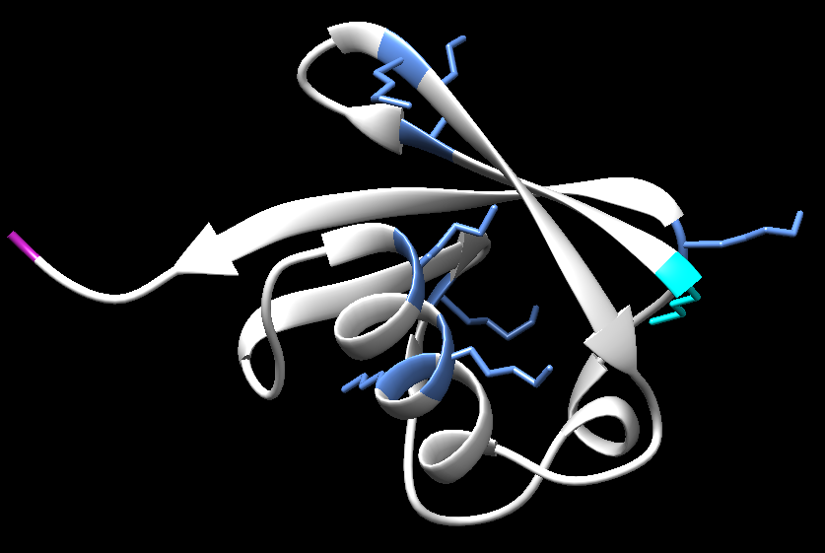
Relevant residues
INTRODUCTION
UBIQUITIN
POLYUBIQUITIN
E1 ENZYMES
CONCLUSIONS
1UBQ
7 Lys
Gly
Met

Slide 21
POLYUBIQUITINS

Slide 22
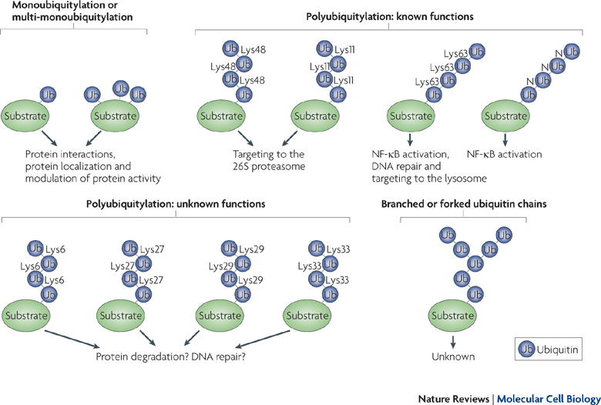
polyubiquitins
INTRODUCTION
UBIQUITIN
POLYUBIQUITIN
E1 ENZYMES
CONCLUSIONS
Ye Yihong, Rape M. Building ubiquitin chains: E2 enzymes at work. Nature. 2009; 10: 755-764

Slide 23
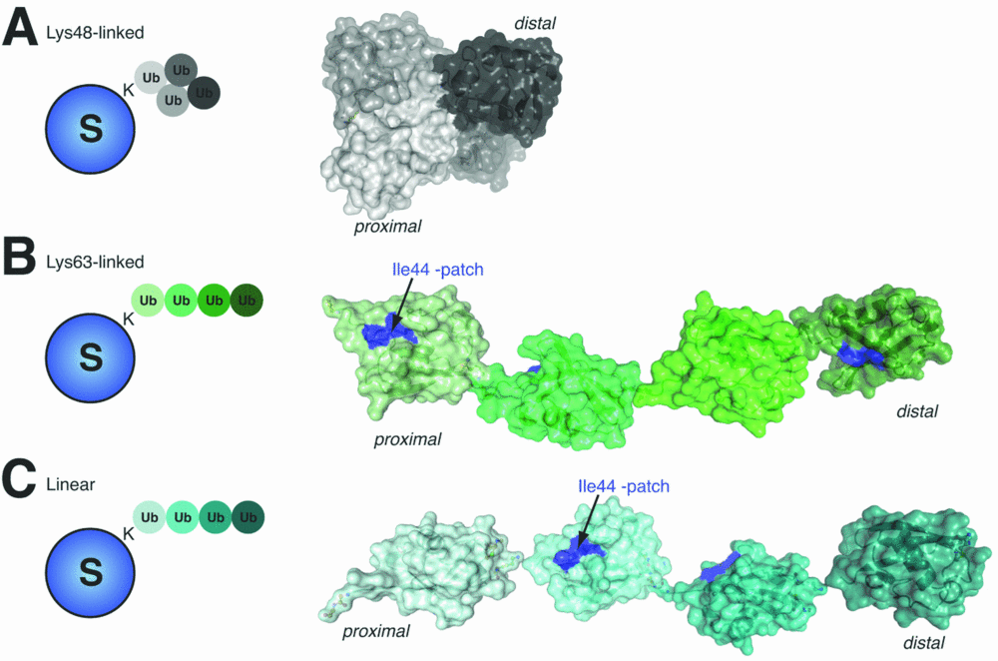
polyubiquitins
INTRODUCTION
UBIQUITIN
POLYUBIQUITIN
E1 ENZYMES
CONCLUSIONS
Komander D. The emerging complexity of protein ubiquitination. Biochem Soc Trans. 2009 Oct; 37:937-53.

Slide 24
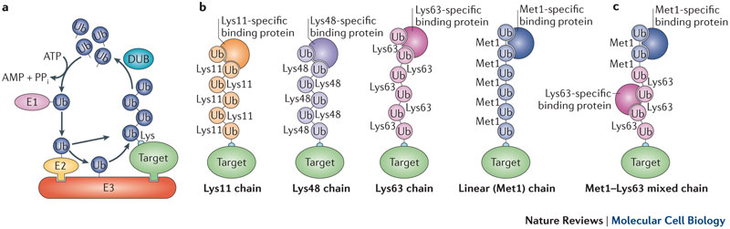
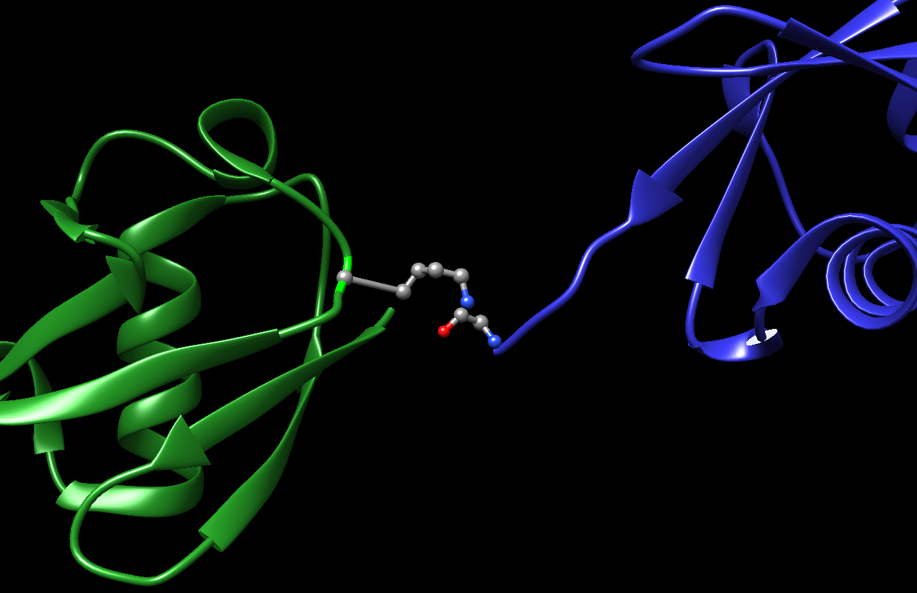
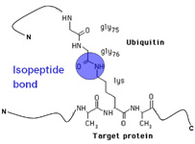
LINEAR CHAINS
INTRODUCTION
UBIQUITIN
POLYUBIQUITIN
E1 ENZYMES
CONCLUSIONS
Ub1 Lys63
Ub2 Gly76
Iwai K, Fujita H, Sasaki Y.. Linear ubiquitin chains: NF-κB signalling, cell death and beyond. Nature molecular cell biology. 2014;15:503-508.
2JF5

Slide 25
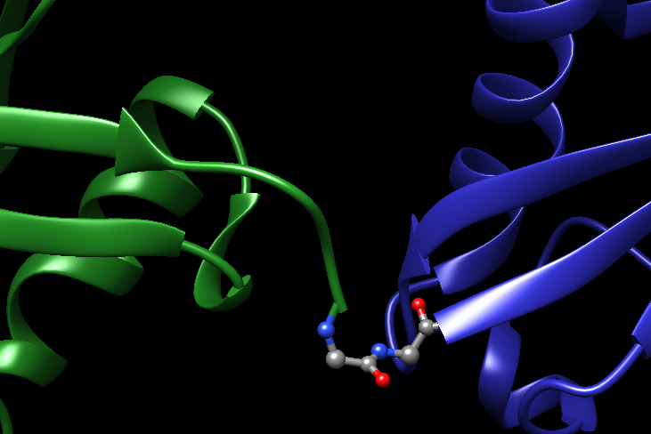
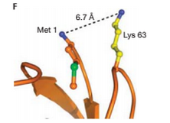
LINEAR CHAINS
INTRODUCTION
UBIQUITIN
POLYUBIQUITIN
E1 ENZYMES
CONCLUSIONS
Iwai K, Fujita H, Sasaki Y.. Linear ubiquitin chains: NF-κB signalling, cell death and beyond. Nature molecular cell biology. 2014;15:503-508.
Met1
Gly76
2W9N
Komander D, Rape M. The ubiquitin code. Annu Rev Biochem. 2012;81:203-29.

Slide 26
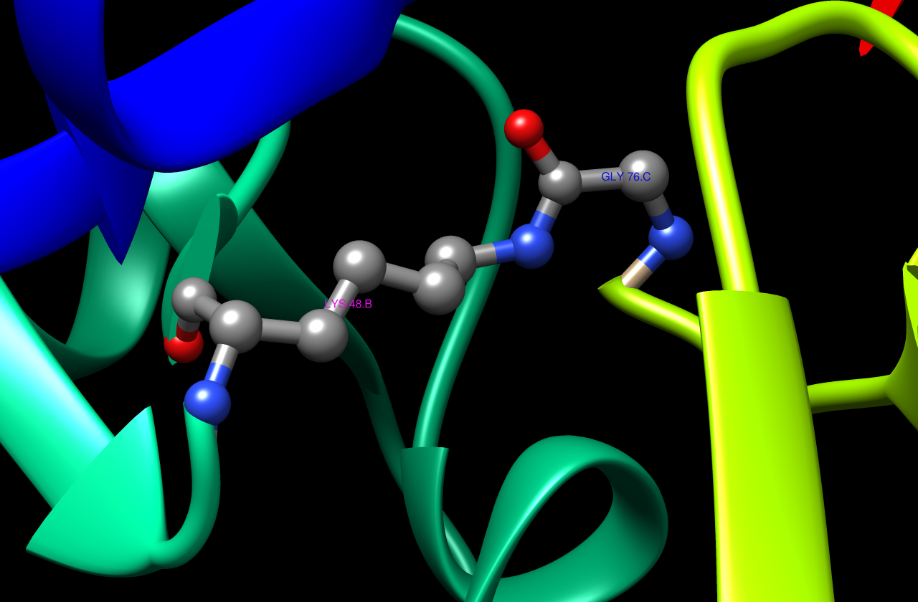
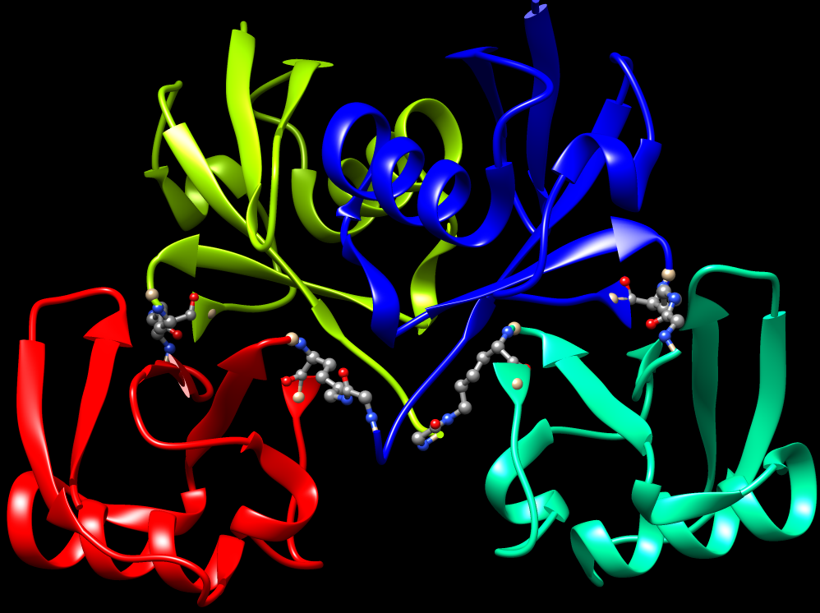
Tetraubiquitin
INTRODUCTION
UBIQUITIN
POLYUBIQUITIN
E1 ENZYMES
CONCLUSIONS
1F9J
Ub2 Gly
1F9J
Ub1 Lys48
Iwai K, Fujita H, Sasaki Y. Linear ubiquitin chains: NF-κB signalling, cell death and beyond. Nature molecular cell biology. 2014;15:503-508.

Slide 27
E1 ENZYMES

Slide 28
PDB STRUCTURES
INTRODUCTION
UBIQUITIN
POLYUBIQUITIN
E1 ENZYMES
CONCLUSIONS
PDB code | Protein | Species | Substrates and ligands | Resolution | Release date
3CMM | Uba1 | Saccharomyces cervisiae | Ubiquitin | 2.70 Å | 2008
4NNJ | Uba1 | Saccharomyces cervisiae | Ubiquitin-AMP Ubiquitin-thioester | 2.40 Å | 2014
1JW9 | MoeB | Escherichia coli | MoaD | 1.70 Å | 2001
4P22 | Ube1 (fragment) | Homo sapiens |  | 2.75 Å | 2015

Slide 29
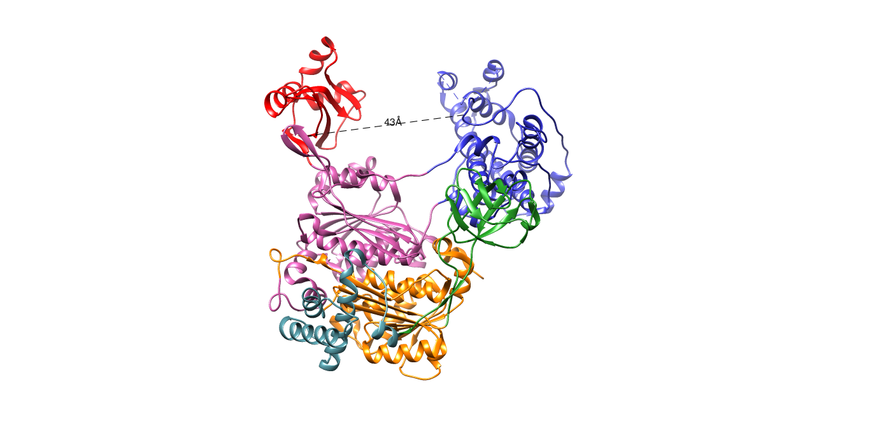
E1 STRUCTURE
INTRODUCTION
UBIQUITIN
POLYUBIQUITIN
E1 ENZYMES
CONCLUSIONS
IAD: Inactive Adenylation Domain
AAD: Active Adenylation Domain
FCCH: First Catalytic Cysteine Half-domain
SCCH: Second Catalytic Cysteine Half-domain
4HB: 4 Helix Bundle
UFD: Ubiquitin Fold Domain
3CMM (UBA1 – yeast)

Slide 30
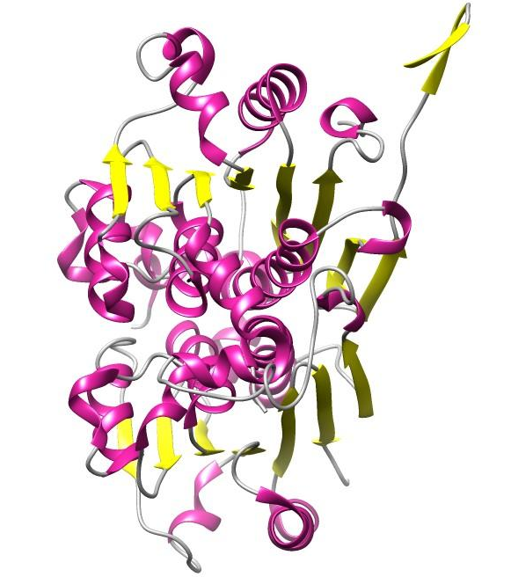
DOMAINS: ADENYLATION DOMAINS
INTRODUCTION
UBIQUITIN
POLYUBIQUITIN
E1 ENZYMES
CONCLUSIONS
Class: α/β
MoeB/ThiF domain
3 layers (α/β/α)
7 β-strands → mostly parallel
AAD
IAD
3CMM (UBA1 – yeast)

Slide 31
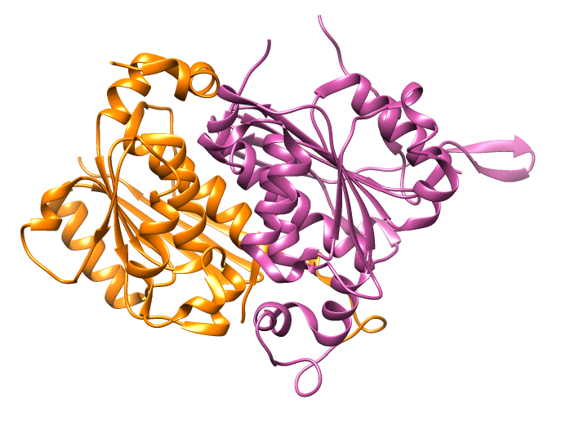
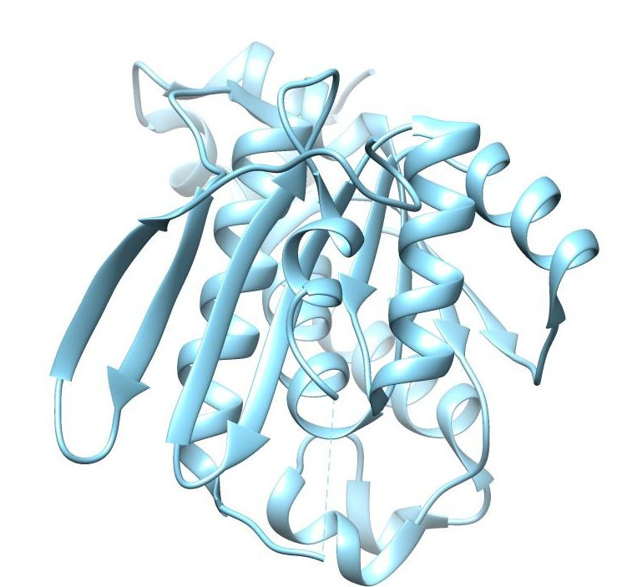
DOMAINS: ADENYLATION DOMAINS
INTRODUCTION
UBIQUITIN
POLYUBIQUITIN
E1 ENZYMES
CONCLUSIONS
3CMM (UBA1 – yeast)
1JW9 (MoeB – E. coli)

Slide 32
E1 STRUCTURE
INTRODUCTION
UBIQUITIN
POLYUBIQUITIN
E1 ENZYMES
CONCLUSIONS
IAD
FCCH
4HB
IAD
AAD
SCCH
AAD
UFD
Central canyon
IAD: Inactive Adenylation Domain
AAD: Active Adenylation Domain
FCCH: First Catalytic Cysteine Half-domain
SCCH: Second Catalytic Cysteine Half-domain
4HB: 4 Helix Bundle
UFD: Ubiquitin Fold Domain
Crossover loop
3CMM (UBA1 – yeast)

Slide 33
E1 STRUCTURE
INTRODUCTION
UBIQUITIN
POLYUBIQUITIN
E1 ENZYMES
CONCLUSIONS
IAD
FCCH
4HB
IAD
AAD
SCCH
AAD
UFD
Tioester formation
Adenylation
IAD: Inactive Adenylation Domain
AAD: Active Adenylation Domain
FCCH: First Catalytic Cysteine Half-domain
SCCH: Second Catalytic Cysteine Half-domain
4HB: 4 Helix Bundle
UFD: Ubiquitin Fold Domain
3CMM (UBA1 – yeast)

Slide 34
UBIQUITIN ACTIVATION
INTRODUCTION
UBIQUITIN
POLYUBIQUITIN
E1 ENZYMES
CONCLUSIONS
UB
E1
AAD
UB
+ ATP
UB
AMP
SCCH
UB
E2
E2
Catalytic Cysteine (Cys 600)
UB

Slide 35
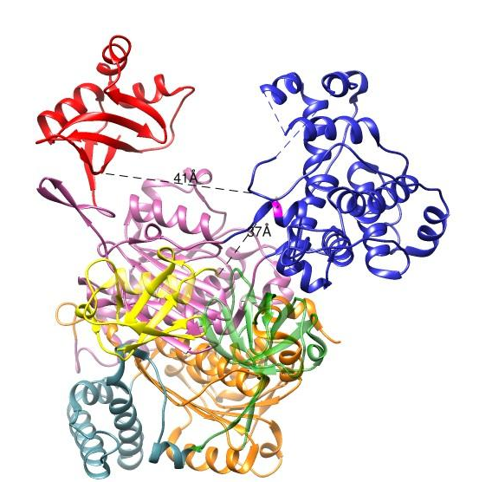
STEP 1: E1 - Ub
INTRODUCTION
UBIQUITIN
POLYUBIQUITIN
E1 ENZYMES
CONCLUSIONS
Does not require ATP
Non covalent interactions
3 interfaces
IAD: Inactive Adenylation Domain
AAD: Active Adenylation Domain
FCCH: First Catalytic Cysteine Half-domain
SCCH: Second Catalytic Cysteine Half-domain
4HB: 4 Helix Bundle
UFD: Ubiquitin Fold Domain
Ubiquitin
3CMM (UBA1 – yeast)

Slide 36
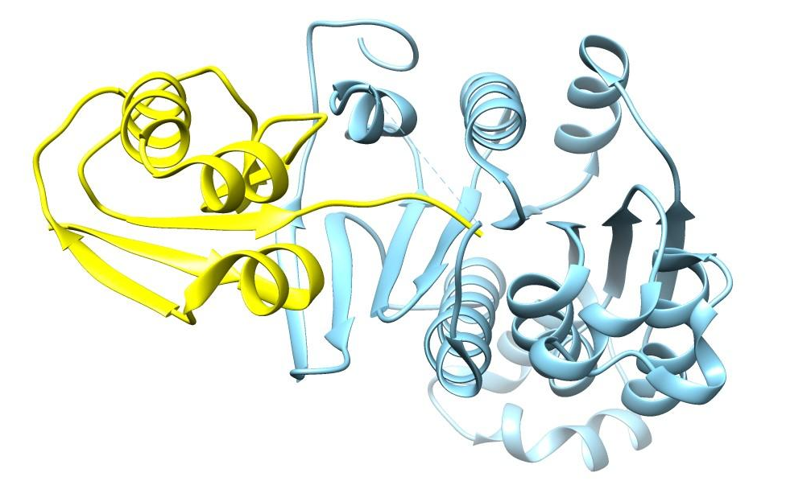
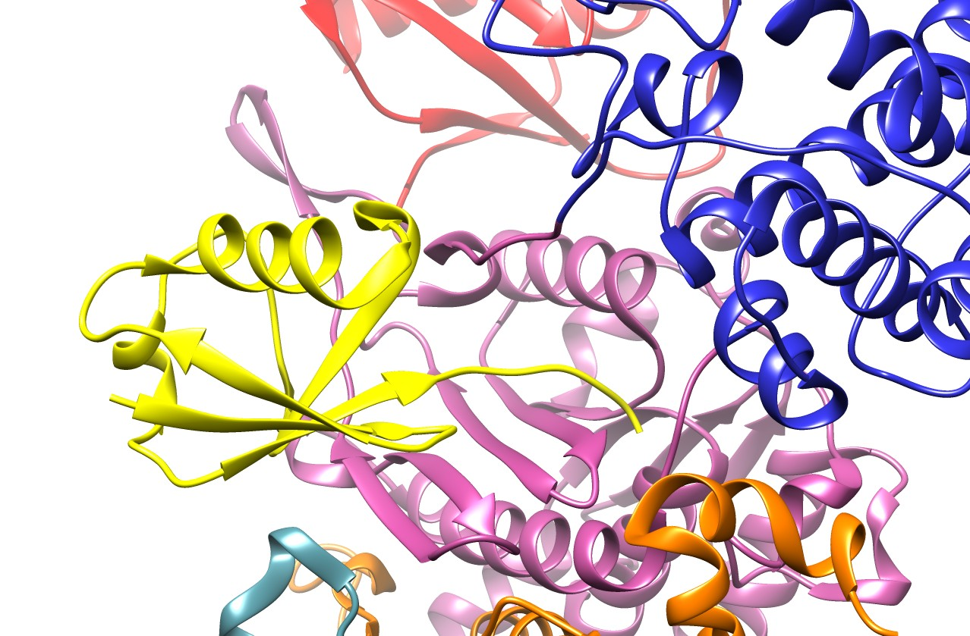
STEP 1: E1 - Ub
INTRODUCTION
UBIQUITIN
POLYUBIQUITIN
E1 ENZYMES
CONCLUSIONS
3CMM (UBA1 – yeast)
1JW9 (MoeB – MoaD from E. coli)

Slide 37
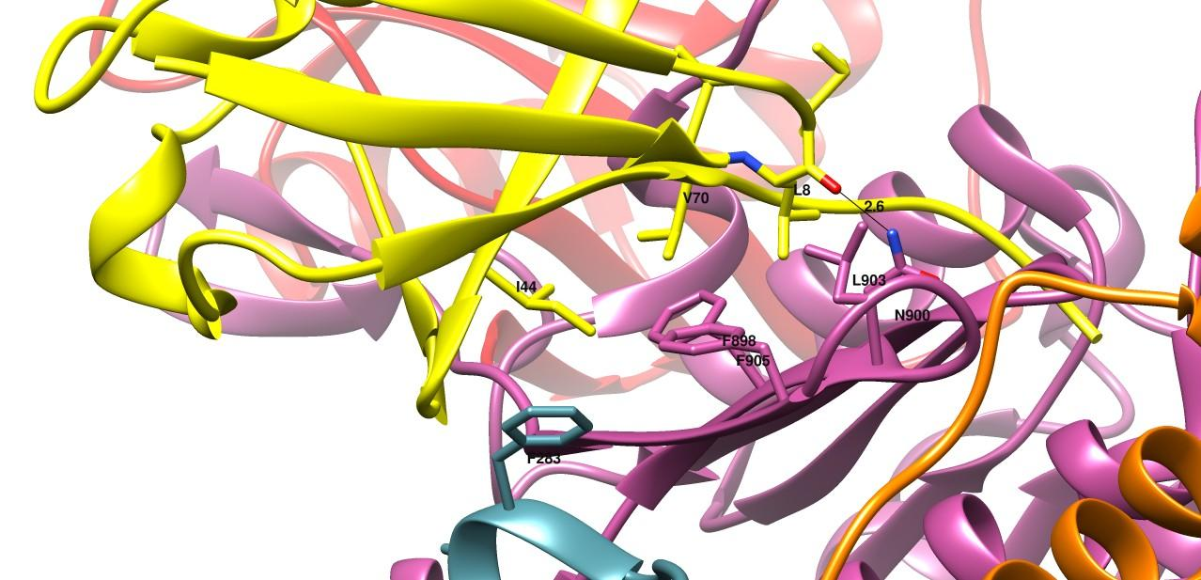
STEP 1: E1 - Ub
INTRODUCTION
UBIQUITIN
POLYUBIQUITIN
E1 ENZYMES
CONCLUSIONS
Interface I: Hydrophobic interactions + H bond
3CMM
(UBA1 – yeast)

Slide 38
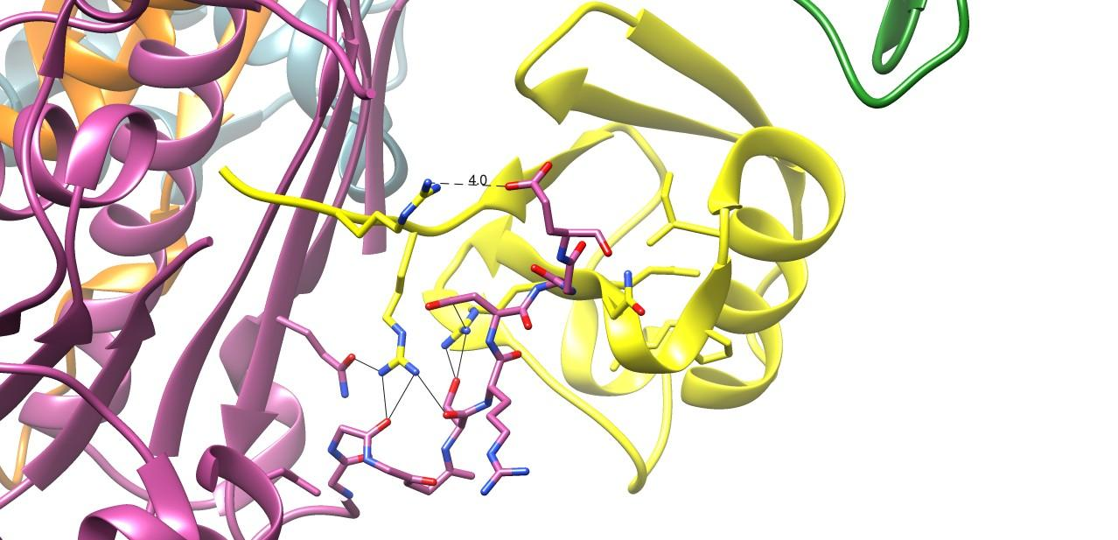
Interface II: H bonds + salt bridge
STEP 1: E1 - Ub
INTRODUCTION
UBIQUITIN
POLYUBIQUITIN
E1 ENZYMES
CONCLUSIONS
R74
E594
R72
D591
R42
Q576
S589
Crossover loop
3CMM
(UBA1 – yeast)

Slide 39
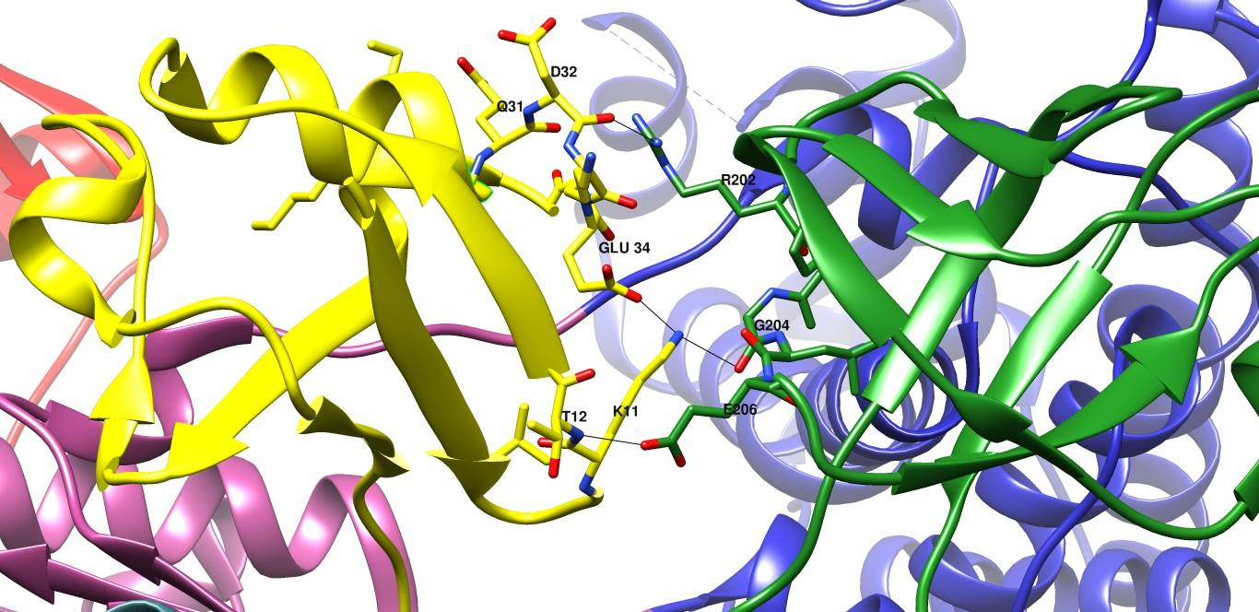
Interface III: more H bonds
STEP 1: E1 - Ub
INTRODUCTION
UBIQUITIN
POLYUBIQUITIN
E1 ENZYMES
CONCLUSIONS
3CMM
(UBA1 – yeast)

Slide 40
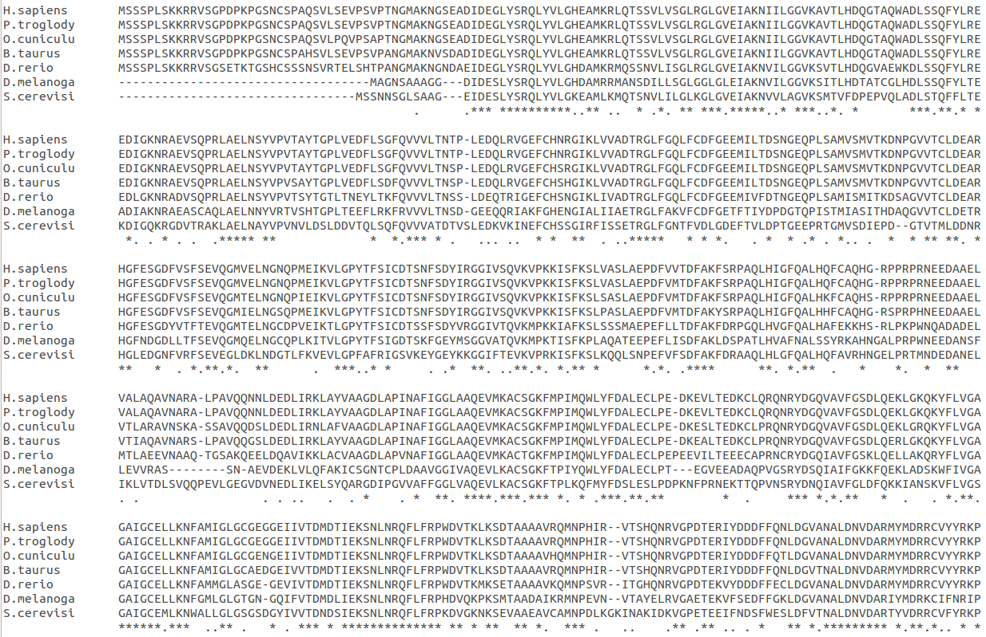
T-coffee

Slide 41
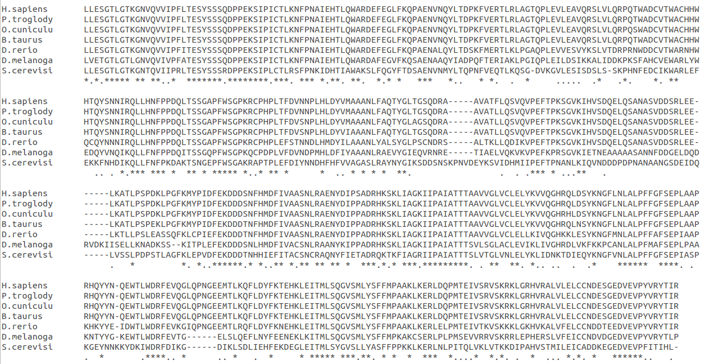
T-coffee

Slide 42
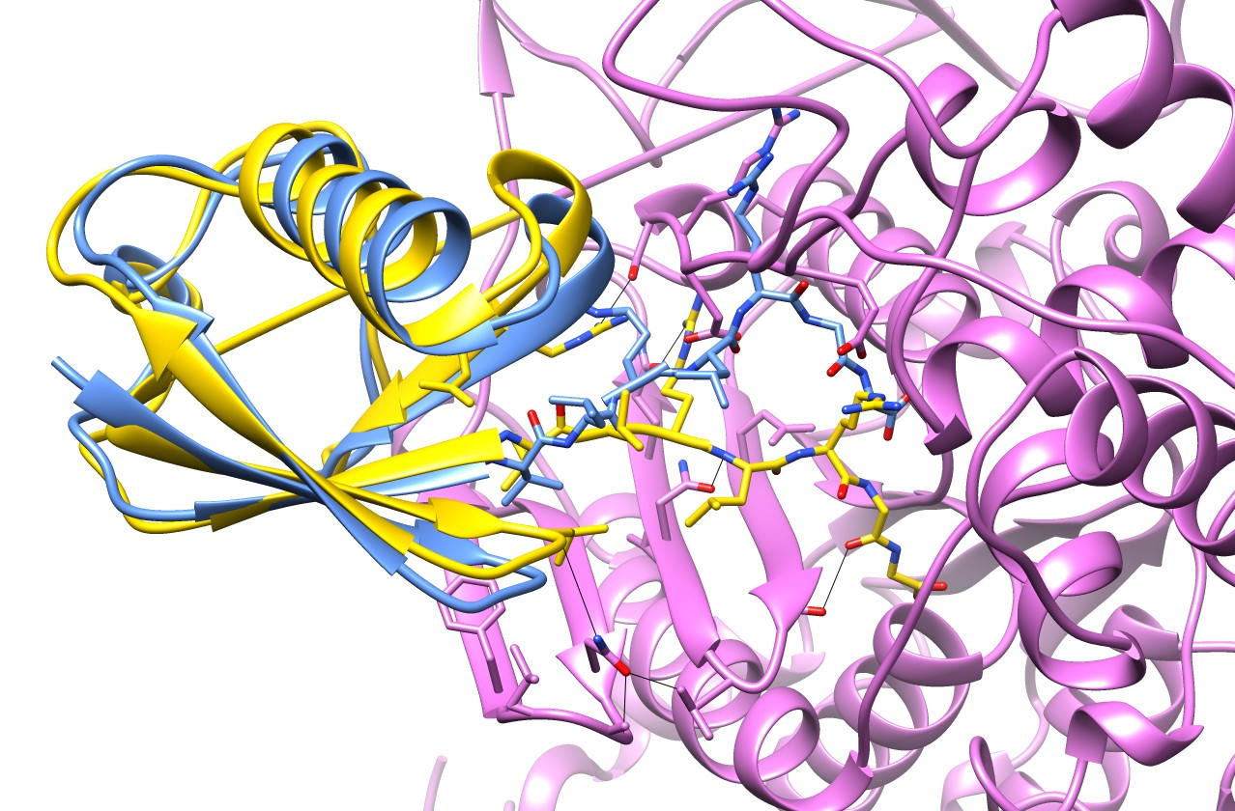
SUPERIMPOSITION OF FREE UB vs e1-UB
INTRODUCTION
UBIQUITIN
POLYUBIQUITIN
E1 ENZYMES
CONCLUSIONS
1UBQ (Ubiquitin – Human)
3CMM (UBA1 – yeast)

Slide 43
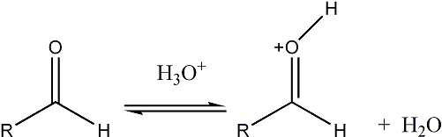
STEP 2: E1 - Ub – AMP
INTRODUCTION
UBIQUITIN
POLYUBIQUITIN
E1 ENZYMES
CONCLUSIONS
E1
O
O
H
N
Ub
⁻O
Mg²⁺
⁻O
O
⁻O
⁻O
⁻O
N
NH2
HO
P
O
P
O
O
P
O
N
N
Nucleophilic Attack
O
O
O
N
OH
OH
PPi
Ub
H
N
O
O⁻
N
NH2
Ub
O
P
O
H
N
O
O⁻
N
NH2
O
O⁻
O
N
N
O
P
O
O
N
N
O
N
O
O
N
⁻O
P
O
OH
OH
OH
O
OH
⁻O
P
O
OH

Slide 44
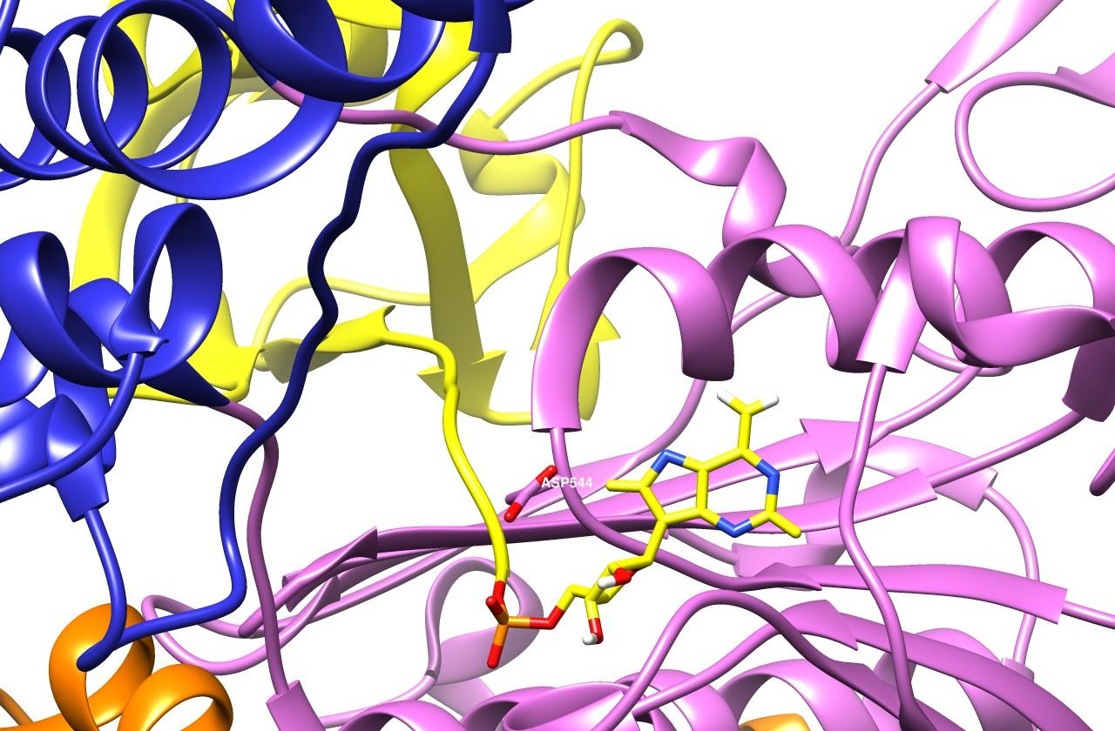
STEP 2: E1 - Ub – AMP
INTRODUCTION
UBIQUITIN
POLYUBIQUITIN
E1 ENZYMES
CONCLUSIONS
4NNJ
(Uba1 – yeast)

Slide 45
STEP 3: THIoESTER FORMATION
INTRODUCTION
UBIQUITIN
POLYUBIQUITIN
E1 ENZYMES
CONCLUSIONS
E1
⁻S
Ub
H
N
O
O⁻
N
NH2
O
P
O
O
N
N
O
O
N
OH
OH
Ub
H
N
O⁻
O⁻
N
NH2
H
N
Ub
O
O⁻
N
NH2
O
P
O
N
HO
P
O
O
S
O
O
N
N
S
O
N
N
O
O
N
E1
OH
OH
E1
OH
OH

Slide 46
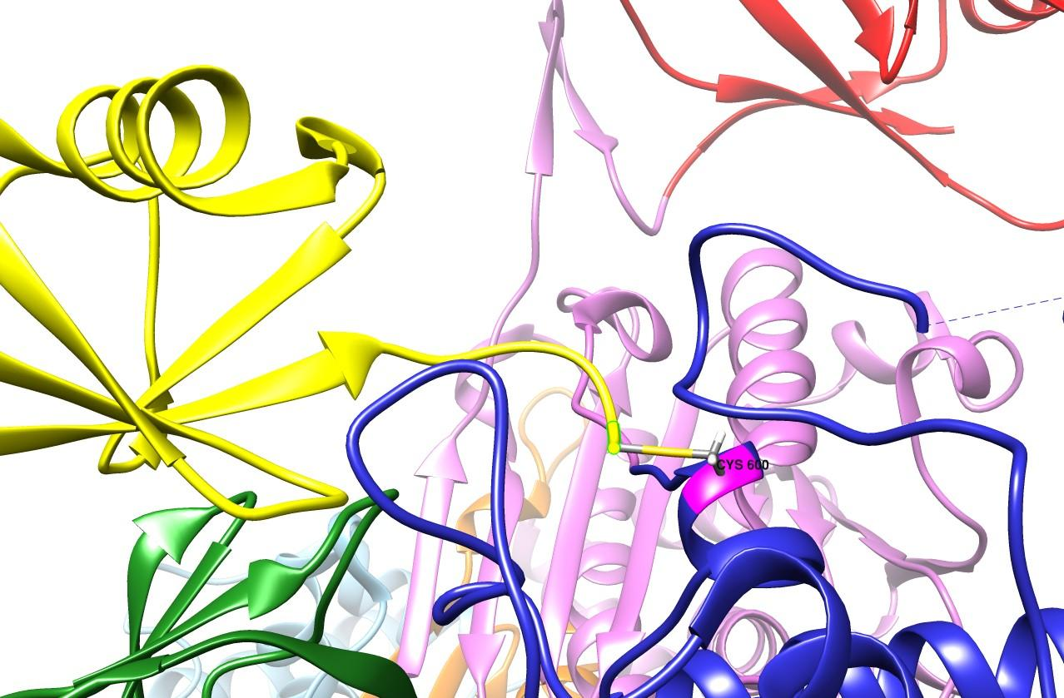
STEP 3: THIoESTER FORMATION
INTRODUCTION
UBIQUITIN
POLYUBIQUITIN
E1 ENZYMES
CONCLUSIONS
4NNJ
(Uba1 – yeast)

Slide 47
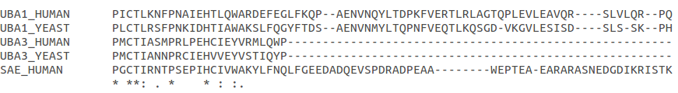
Catalytic cysteine conservation
INTRODUCTION
UBIQUITIN
POLYUBIQUITIN
E1 ENZYMES
CONCLUSIONS
Among species
Among UBL activating enzymes

Slide 48

E1 loaded with two ubiquitins
INTRODUCTION
UBIQUITIN
POLYUBIQUITIN
E1 ENZYMES
CONCLUSIONS
4NNJ
(Uba1 – yeast)

Slide 49

HUMAN e1
INTRODUCTION
UBIQUITIN
POLYUBIQUITIN
E1 ENZYMES
CONCLUSIONS
SUPERIMPOSITION OF THE FIRST CRISTALYZED FRAGMENT OF E1 FROM HUMAN
4P22 (UBE1 – human)
3CMM (UBA1 – yeast)

Slide 50
Conclusions
INTRODUCTION
UBIQUITIN
POLYUBIQUITIN
E1 ENZYMES
CONCLUSIONS
Ubiquitin is a small highly conserved protein among eukaryotic species.
Ubiquitination is a post-translational modification that leads to protein degradation.
Ubiquitin secondary structure consists on a beta-grasp fold, also present in ubiquitin-like proteins.
Lysines are important residues for polyubiquitin-chains formation.
Ubiquitin is covalently attached to other proteins by its last C-terminal glycine.
Ubiquitin C-terminal tail plays a crucial role in its activation by E1 enzymes.
This glycine-glycine C-terminus is conserved in both prokaryotes, eukaryotes and ubiquitin-like proteins.

Slide 51
REferences
Bedford L, Lowe J, Dick LR, R. Mayer J, Brownell JE. Ubiquitin-like protein conjugation and the ubiquitin–proteasome system as drug targets. Nat Rev. 2011; 10: 29-46.
Grau-Bové X, Sebé-Pedrós A,i Ruiz-Trillo I.The Eukaryotic Ancestor Had a Complex Ubiquitin Signaling System of Archaeal Origin. Mol Biol Evol. 2015 Mar; 32(3): 726–739.
Kirkpatrick DS, Denison C, Gygi SP. Weighing in on ubiquitin: the expanding role of mass-spectrometry-based proteomics. Nat Cell Biol. 2005 Aug;7(8):750-7.
Komander D. The emerging complexity of protein ubiquitination. Biochem Soc Trans. 2009 Oct; 37:937-53.
Komander D, Rape M. The ubiquitin code. Annu Rev Biochem. 2012;81:203-29.
Komander D, Claque MJ, Urbé S. Breaking the chains: structure and function of the deubiquitinases. Nat Rev. 2009; 10: 550-563.
Komander D1, Reyes-Turcu F, Licchesi JD, Odenwaelder P, Wilkinson KD, Barford D. Molecular discrimination of structurally equivalent Lys 63-linked and linear polyubiquitin chains. EMBO Rep. 2009 May;10:466-73.
Iwai K, Fujita H, Sasaki Y. Linear ubiquitin chains: NF-κB signalling, cell death and beyond. Nat Rev Mol Cell Biol. 2014;15: 503-508.
Hickey CM, Wilson NR, Hochstrasser M. Function and regulation of SUMO proteases. Nat Rev. 2012; 13: 755-766.
Enchev RI, Schulman BA, Peter M. Protein neddylation: beyond cullin-RING ligases. Nat Rev Mol Cell Biol. 2015; 16: 30-44.
Olsen SK, Capili AD, Lu X, Tan DS, Lima CD. Active site remodelling accompanies thioester bond formation in the SUMO E1. Nature. 2010; 463(7283): 906-912.

Slide 52
references
Piana S, Lindorff-Larsena K, E. Shawa D. Atomic-level description of ubiquitin folding.Proc Natl Acad Sci U S A. 2013 Apr 9;110(15):5915-20.
Pickart CM1, Fushman D. Polyubiquitin chains: polymeric protein signals. Curr Opin Chem Biol. 2004 Dec;8(6):610-6.
Radici L, Bianchi M, Crinelli R, Magnani M. Ubiquitin C gene: Structure, function, and transcriptional regulation. Adv Biosci Biotechnol. 2013; 4:1057-1062.
Schäfer A, Kuhn M, Schindelin H. Structure of the ubiquitin-activating enzyme loaded with two ubiquitin molecules. Acta Crystallogr D Biol Crystallogr. 2014; 70: 1311-1320.
Varadan R1, Walker O, Pickart C, Fushman D. Structural properties of polyubiquitin chains in solution.J Mol Biol. 2002 Dec 6;324(4):637-47.
Vargas MPA. Structural and Functional Studies on the Ubiquitin-Specific Protease Family. [Thesis]. Rotterdam: Erasmus Universiteit Rotterdam; 2009.
Vucic D, Dixit VM, Wertz HE. Ubiquitylation in apoptosis: a post-translational modification at the edge of life and death. Nat Rev. 2011; 12:439-452.
Walden H, Podgorski MS, Huang DT, Miller DW, Howard RJ, Minor DL Jr, Holton JM, Schulman BA. The structure of the APPBP1-UBA3-NEDD8-ATP complex reveals the basis for selective ubiquitin-like protein activation by an E1. Mol Cell. 2003 Dec;12(6):1427-37.
Lee I, Schindelin H. Structural insights into E1-catalyzed ubiquitin activation and transfer to conjugating enzymes. Cell. 2008; 134(2):268-278.
Van der Veen AG, Ploegh HL.Ubiquitin-like proteins. Annu Rev Biochem. 2012;81:323-57.
Ye Yihong, Rape M. Building ubiquitin chains: E2 enzymes at work. Nat Rev Mol Cell Biol. 2009; 10: 755-764
Zuin A, Isasa M, Crosas B. Ubiquitin signaling: extreme conservation as a source of diversity. Cells. 2014; 3(3):690-701.

Slide 53
references
Piana S, Lindorff-Larsena K, E. Shawa D. Atomic-level description of ubiquitin folding.Proc Natl Acad Sci U S A. 2013 Apr 9;110(15):5915-20.
Pickart CM1, Fushman D. Polyubiquitin chains: polymeric protein signals. Curr Opin Chem Biol. 2004 Dec;8(6):610-6.
Radici L, Bianchi M, Crinelli R, Magnani M. Ubiquitin C gene: Structure, function, and transcriptional regulation. Adv Biosci Biotechnol. 2013; 4:1057-1062.
Schäfer A, Kuhn M, Schindelin H. Structure of the ubiquitin-activating enzyme loaded with two ubiquitin molecules. Acta Crystallogr D Biol Crystallogr. 2014; 70: 1311-1320.
Varadan R1, Walker O, Pickart C, Fushman D. Structural properties of polyubiquitin chains in solution.J Mol Biol. 2002 Dec 6;324(4):637-47.
Vargas MPA. Structural and Functional Studies on the Ubiquitin-Specific Protease Family. [Thesis]. Rotterdam: Erasmus Universiteit Rotterdam; 2009.
Vucic D, Dixit VM, Wertz HE. Ubiquitylation in apoptosis: a post-translational modification at the edge of life and death. Nat Rev. 2011; 12:439-452.
Walden H, Podgorski MS, Huang DT, Miller DW, Howard RJ, Minor DL Jr, Holton JM, Schulman BA. The structure of the APPBP1-UBA3-NEDD8-ATP complex reveals the basis for selective ubiquitin-like protein activation by an E1. Mol Cell. 2003 Dec;12(6):1427-37.
Lee I, Schindelin H. Structural insights into E1-catalyzed ubiquitin activation and transfer to conjugating enzymes. Cell. 2008; 134(2):268-278.
Van der Veen AG, Ploegh HL.Ubiquitin-like proteins. Annu Rev Biochem. 2012;81:323-57.
Ye Yihong, Rape M. Building ubiquitin chains: E2 enzymes at work. Nat Rev Mol Cell Biol. 2009; 10: 755-764
Zuin A, Isasa M, Crosas B. Ubiquitin signaling: extreme conservation as a source of diversity. Cells. 2014; 3(3):690-701.

Slide 54
1. Ubiquitin is the most representative protein of:
a) Greek-key beta barrel fold.
b) Beta-grasp fold.
c) Both a and b are correct.
d) Rossmann fold.
e) All the answers above are incorrect.
2. Ubiquitin is covalently attach to other proteins by its:
a) Last C-terminal glycine.
b) First N-terminal glycine.
c) Last C-terminal lysine.
d) Both C-terminal lysine and glycine.
e) Leucine and isoleucine residues.
3. The interaction formed between ubiquitin last glycine and active-site-cysteine of E1 enzyme is a:
a) Isopeptide bond.
b) Peptide bond.
c) Hydrogen bond.
d) Non-covalent interactions.
e) Thioester bond.
4. Ubiquitin activation consists on a:
a) Proteolytic cleavage.
b) Both adenylation and thioester bond formation.
c) Adenylation reaction.
d) Thioester bond formation.
e) Phosphorylation.
5. Which are ubiquitin-like proteins?
a) NF-kβ.
b) E1 and E2.
c) Immunoglobulines.
d) NEDD8 and SUMO.
e) ThiF and MoeB.
6. Which patch or patches in ubiquitin surface are hydrophobic:
a) TEK-box.
b) Phe4 and Ile36.
c) β1-β2 loop and Ile44.
d) TEK-box and Phe4.
e) Ile36 and Ile44.
7. About ubiquitin activation by E1 enzymes:
a) The catalytic cysteine is near the adenylation domain.
b) All the six domains of E1 interact with ubiquitin.
c) Catalytic cysteine domains are far away from adenylation domains.
d) There are no catalytic domains.
e) Catalytic cysteine is placed adenylation domains.
8. About polyubiquitin chains.
a) Tetramers are formed by lysine 48-linked ubiquitins.
b) Straight chains are formed by lysine 48 and 63-linked ubiquitins.
c) Lysine 48-linked ubiquitins have a non-proteolytic function.
d) They are linked by a thioester bond.
e) All the answers above are correct.
9. About ubiquitin origin and conservation.
a) MoaD and ThiS are ubiquitin prokaryotic ancestors.
b) Non ubiquitin-related proteins have been found in archaea.
c) MoeB and ThiF are ubiquitin prokaryotic ancestors.
d) Ubiquitin is only conserved among mammal species.
e) Urm1 also shares an immunoglobulin fold.
10. About ubiquitin activating enzyme (E1) structure.
a) It only presents two domains.
b) Structural domains are placed one after the other in sequence.
c) The adenylation domain recruits E2 enzyme.
d) It presents small loops.
e) They have six structural domains.

